Slide 1
EMPLOYEE SALARY MANAGEMENT SYSTEM

Slide 2

DEVELOPED BY:
1. PRIYANSHU SAHOO (B-TECH-4th YEAR/AUK)
2. KARANDEEP SINGH (BCA-3rd YEAR/AJU)
3. SIMRAN KHAN(B-TECH-4th YEAR/BBIT)
4. SOUMYADIP CHATTERJEE (B-TECH-4th YEAR/RCCIIT)
5. RITAM KAR(B-TECH-4th YEAR/RCCIIT)
6. MEGHANA MITRA(B-TECH-3rd YEAR/DYPU)

Slide 3

ACKNOWLEDGEMENT
We would like to express our deepest gratitude to everyone who contributed to the successful completion of our project, "Employee Salary Management System."
Firstly, we extend our heartfelt thanks to our instructor, Miss Rohini Bose(SE/IT,IT CENTRE,SER,GRC), for her invaluable guidance, support, and encouragement throughout the duration of this project. Her insights and expertise were instrumental in shaping our project and ensuring its success.
We also wish to thank our team members for their dedication, hard work, and collaboration. The shared effort and collective input from each member were crucial in overcoming challenges and achieving our objectives.

Slide 4
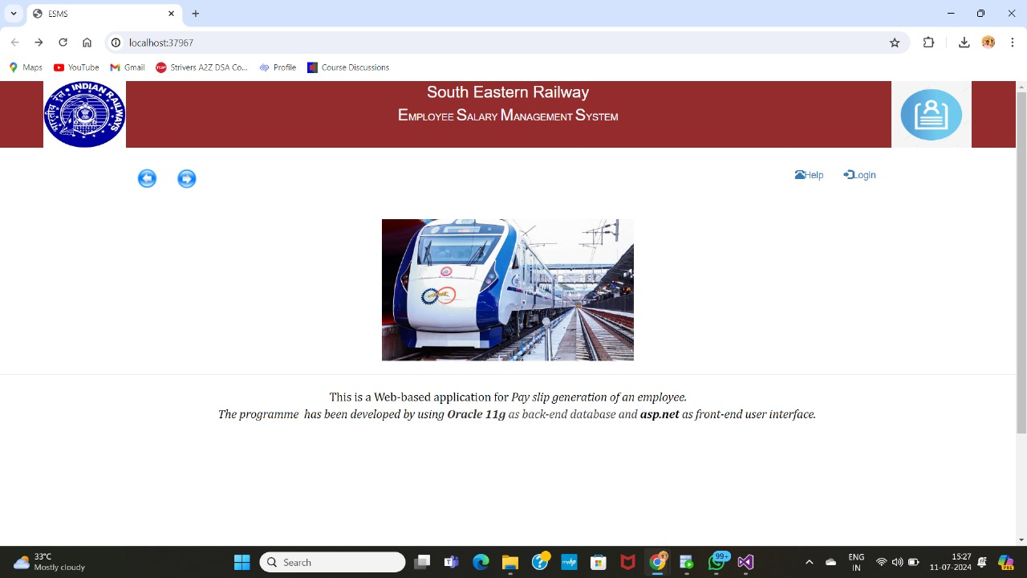
INTRODUCTION
We have develop a web-based application to automate the generation and distribution of employee pay slips, reducing manual workload, minimizing errors, and enhancing data security.
Key Features:
Automated Salary Calculation
Digital Pay Slips
Employee Management
Report Generation
Technology Used:
Frontend: HTML, CSS
Backend: Oracle 11g

Slide 5

SYNOPSIS
An employee salary management system is a software solution designed to automate and streamline payroll processes. This project aims to improve payroll accuracy, efficiency, and compliance .
i. Pros:
Efficiency and Accuracy
Compliance and Data Security
ii. Cons:
Initial Complexity & Data security
Technical Dependence

Slide 6
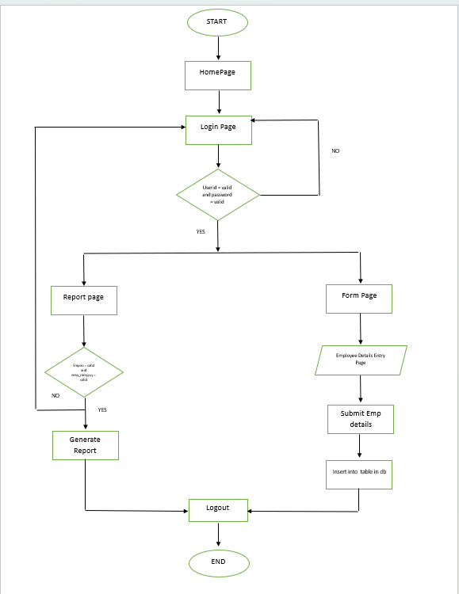
FLOWCHART

Slide 7
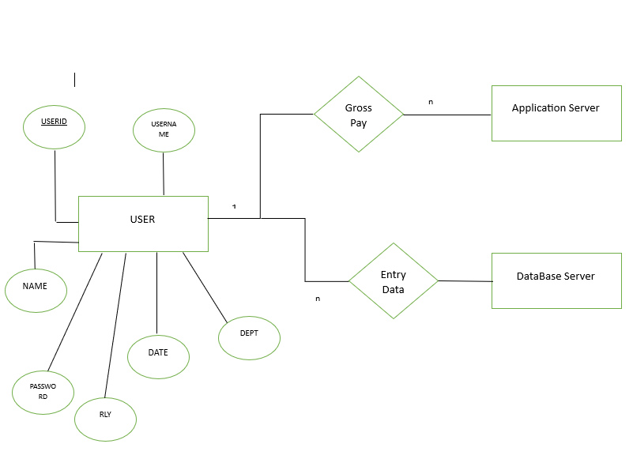
E.R. DIAGRAM

Slide 8
BIBLIOGRAPHY
TutorialsPoint. (n.d.). Oracle PL/SQL - Quick Guide. Retrieved from https://www.tutorialspoint.com/plsql/plsql_quick_guide.htm
W3Schools. (n.d.). ASP.NET Tutorial. Retrieved from https://www.w3schools.com/asp/
Stack Overflow. (n.d.). ASP.NET Questions and Answers. Retrieved from https://stackoverflow.com/questions/tagged/asp.net
Oracle. (n.d.). Oracle Database 11g Documentation. Retrieved from https://docs.oracle.com/cd/B28359_01/index.htm
Microsoft. (n.d.). Visual Studio 2013 Documentation. Retrieved from https://docs.microsoft.com/en-us/visualstudio/2013

Slide 9
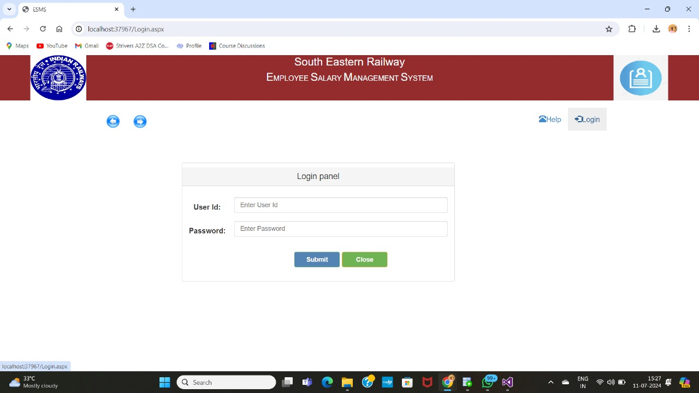
SCREENSHOTS

Slide 10
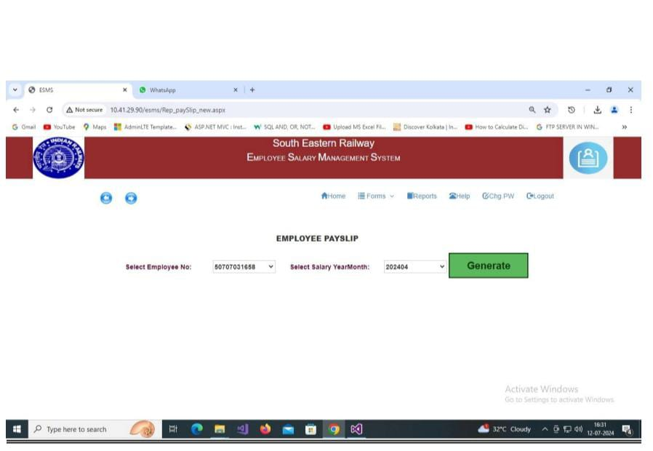
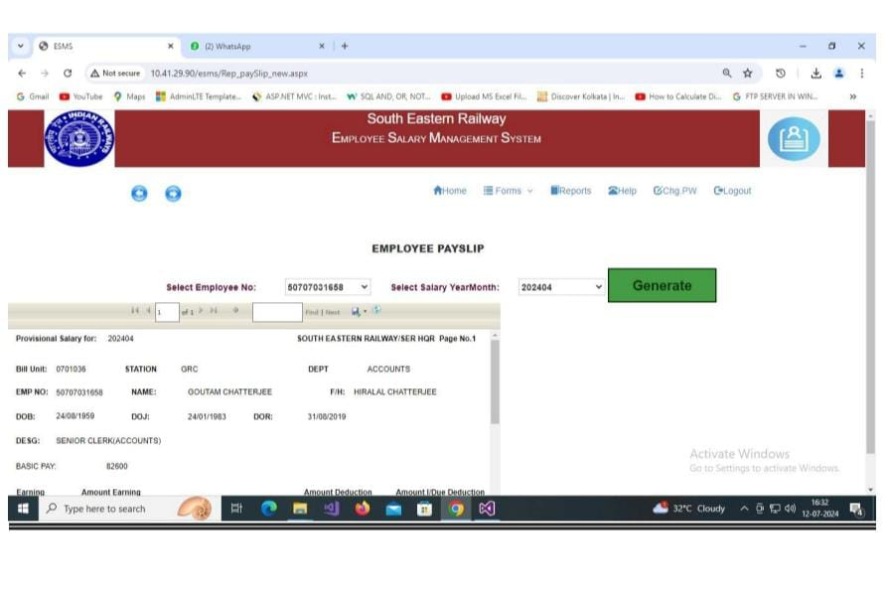
SCREENSHOTS

Slide 11
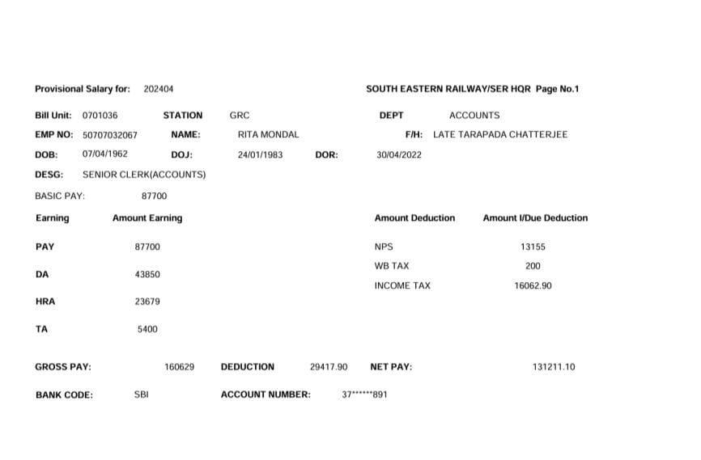
FINAL PAYSLIP SCREENSHOT

